Slide 1
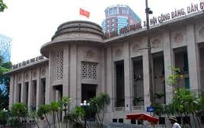

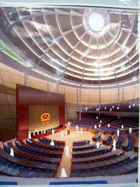
Chính phủ điện tử
TS. Phạm Văn Tính
Khoa CNTT, ĐH Nông Lâm TP.HCM
pvtinh@hcmuaf.edu.vn

Slide 2
Outline
Motivation
Comparing action controllers to action listeners
Action listeners
Value change listeners
Using JavaScript to submit form

Slide 3
Motivation
There are two varieties of user interface events
Events that start back-end processing
Events that affect only the format of the user interface
JSF categorizes code that handles these as action controllers and event listeners
Action controllers handle main form submission
Fire after bean has been populated
Fire after validation logic
Return strings that directly affect page navigation
Event listeners handle UI events
Often fire before bean has been populated
Often bypass validation logic
Never directly affect page navigation

Slide 4
Types of Event Listeners
ActionListener
Fired by buttons, image maps, and hypertext links (links have attached JavaScript)
<h:commandButton value="..." .../>
<h:commandButton image="..." .../>
<h:commandLink .../>
Automatically submit the form
ValueChangeListener
Fired by combo boxes, checkboxes, radio buttons, textfields, and others
<h:selectOneMenu .../>
<h:selectBooleanCheckbox.../>
<h:selectOneRadio .../>
<h:inputText .../>
Do not automatically submit the form

Slide 5
Action Listeners

Slide 6
Using ActionListener in Facelets
Some buttons submit the form and start backend processing
Use <h:commandButton action="..." ...>
Other buttons affect only the UI
Use <h:commandButton actionListener="..." .../>
You usually want this process to occur before beans are populated and especially before validation occurs
Since forms are often incomplete when the UI is adjusted
Use “immediate” to designate that listener fires before validation is performed or beans are populated
<h:commandButton actionListener="..."
immediate="true" .../>

Slide 7
Implementing ActionListener
Method takes ActionEvent as agument
Void return type (not String as in action controllers)
ActionEvent is in javax.faces.event
ActionEvent has a getComponent method that lets you obtain the UIComponent reference
From the UIComponent, you can get the component ID, renderer, and other low-level information
Sample code
public void someMethod(ActionEvent event) {
doSomeSideEffects();
}

Slide 8
Example
Idea
Adapt the registration example that provide pushbuttons to change the font size.
Approach
Store the name of the body style to be used in the property of a session-scoped bean
<h:body styleClass="#{formSettings.bodyStyleClass}">
Provide two pushbuttons that run action listeners which change the body-style class
<h:commandButton value=“Normal Font Size"
actionListener="#{formSettings.setNormalSize}"
immediate="true"/>
<h:commandButton value="#{msgs.largeFont}"
actionListener="#{formSettings.setLargeSize}"
immediate="true"/>

Slide 9
Input Form: Top (register1.xhtml)
<h:head>
<link href="./css/styles.css"
rel="stylesheet" type="text/css"/>
</h:head>
<h:body styleClass="#{formSettings.bodyStyleClass}">
<h:form>
<fieldset>
<legend>Registration</legend>
<h:panelGrid columns="2">
<h:outputFormat value="Firt Name: " />
<h:inputText value="#{person.firstName}" />
<h:outputFormat value="Last Name: " />
<h:inputText value="#{person.lastName}" />
<h:outputFormat value="Email: " />
<h:inputText value="#{person.emailAddress}" />
</h:panelGrid>
<h:commandButton value="Register me"
action="#{person.doRegistration}" />
</fieldset>

Slide 10
Input Form: Bottom (register1.xhtml)
<br />
<div align="center">
<h:commandButton value="Normal Font Size"
actionListener="#{formSettings.setNormalSize}" immediate="true" />
<h:commandButton value="Large FontSize "
actionListener="#{formSettings.setLargeSize}" immediate="true" />
</div>
</h:form>
</h:body>
</html>

Slide 11
Bean for Action Listener (Bean for Form Settings)
@ManagedBean
public class FormSettings implements Serializable {
private boolean isNormalSize = true;
public String getBodyStyleClass(){
if (isNormalSize) return("normalSize");
else return("largeSize");
}
public void setNormalSize(ActionEvent event) {
isNormalSize = true;
}
public void setLargeSize(ActionEvent event) {
isNormalSize = false;
}
}

Slide 12
Bean for Action Controller (“Main” Bean)
@ManagedBean
public class Person {
private String firstName, lastName, emailAddress;
public String doRegistration() {
if (isAnyEmpty(firstName, lastName, emailAddress)) {
return("missing-input");
} else return("confirm-registration");
}
private boolean isAnyEmpty(String... values) {
for(String value: values) if (isEmpty(value)) return(true);
return(false);
}
private boolean isEmpty(String value) {
return((value == null) || (value.trim().length() == 0));
}
}

Slide 13
CSS File
body { background-color: #fdf5e6; }
.normalSize { font-size: 110% }
.largeSize { font-size: 200% }
legend {
font-weight: bold;
color: black;
background-color: #eeeeee;
border: 1px solid #999999;
padding: 3px 2px;
}

Slide 14
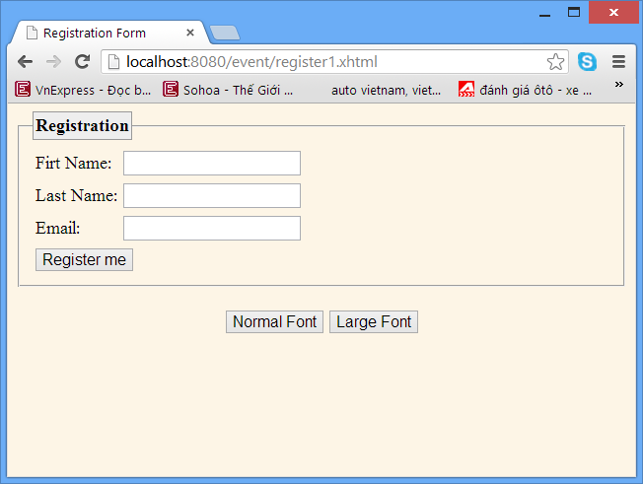
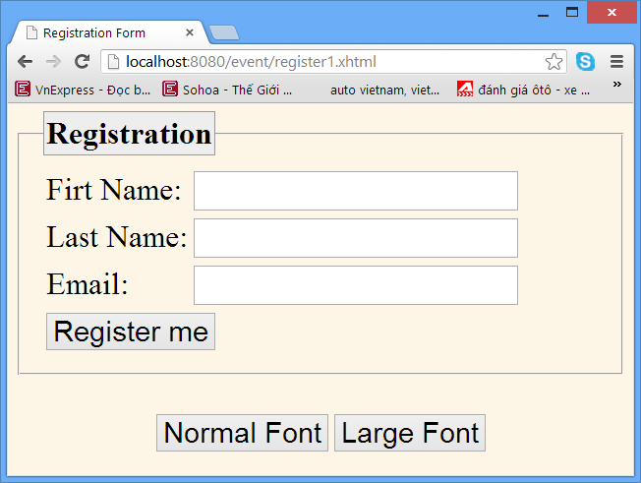
Results: Input Form

Slide 15
Value Change Listeners

Slide 16
Using ValueChangeListener in Facelets
ValueChangeEvent are fired by combobox, listbox, radio button, checkbox, textfield, etc.
Form not automatically submitted
Need to add JavaScript to submit the form onclick="submit()" or onchange="submit()"

Slide 17
Implementing ValueChangeListener
Method takes ValueChangeEvent as arg
Useful ValueChangeEvent methods
getComponent (as mentioned for ActionEvent)
getOldValue (previous value of GUI element)
getNewValue (current value of GUI element)
Needed since bean has probably not been populated
Value for checkbox is of type Boolean
Value for radio button or textfield corresponds to request parameter
Sample code
public void someMethod(ValueChangeEvent event) {
Boolean flag = (Boolean)event.getNewValue();
takeActionBasedOn(flag);
}

Slide 18
Example
<h2>Đăng ký môn học</h2>
<h:panelGrid columns="2">
<h:outputLabel value="Chọn lớp: " />
<h:selectOneMenu id = "gradeID" value="#{userReg.grade}"
valueChangeListener="#{userReg.classChange}" onchange="submit()">
<f:selectItems value="#{userReg.grades}" />
</h:selectOneMenu>
<h:outputLabel value="Chọn môn học: " />
<h:selectOneMenu id = "subjectID" value="#{userReg.subject}">
<f:selectItems value="#{userReg.subjects}" />
</h:selectOneMenu>
</h:panelGrid>
<h:commandButton value="Đăng ký" action="#{userReg.registration}" />

Slide 19
Example
public class UserReg implements Serializable{
private static final long serialVersionUID = 1L;
private String grade = "Năm 1";
private String subject = "Lập trình CB";
private static Map<String,String[]> studyProgram;
static{
studyProgram = new LinkedHashMap<String,String[]>();
studyProgram.put("Năm 1", new String[]{"Lập trình CB", "Nhập môn HDH","Cấu trúc máy tính"});
studyProgram.put("Năm 2", new String[]{"Lập trình nâng cao","CSDL", "Cấu trúc dữ liệu"});
studyProgram.put("Năm 3", new String[]{"Lập trình mạng", "Mạng máy tính","Thiết kế hướng đối tượng"});
}
private String[] subjects = studyProgram.get("Năm 1") ;

Slide 20
Example
public String[] getGrades(){
return studyProgram.keySet().toArray(new String[0]);
}
public String getSubject() {
return subject;
}
public void setSubject(String subject) {
this.subject = subject;
}
public void classChange(ValueChangeEvent event){
setSubjects(studyProgram.get((String)event.getNewValue()));
}

Slide 21
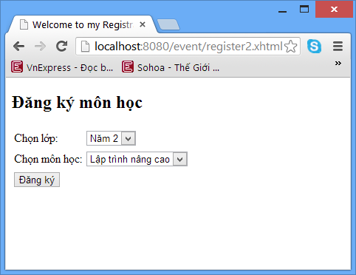
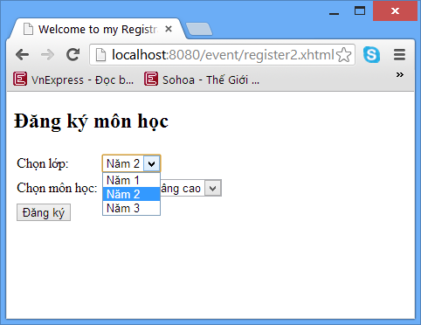
Example

